Slide 1

FINAL YEAR PROJECT 2026
NEXHIRE AI
Smart Employee Recruitment & AI Hiring System
Presented By
Project Supervisor
Shivani (2312133)
Aarian Kumar (2312101)
Sir Asim Riaz

Slide 2

Introduction
  A web based AI assisted employee recruitment system.
  Centralizes vacancies, candidates, applications, interviews, and hiring decisions.
  Provides two interfaces: HR Admin Panel and Candidate Portal.
  Uses AI to evaluate candidate applications against vacancy specific requirements.
  Manages the recruitment lifecycle from job posting to offer generation.
2

Slide 3

Objectives
  Manual CV screening is slow & inconsistent.
  Difficult to compare candidates fairly.
  Recruitment scattered across emails, spreadsheets & manual notes.
  Lack of Centralized Tracking .
  Lack of a complete application to hiring audit trail.
  Interview scheduling & feedback involve manual coordination.
  Duplicate Applications.
Problem Statement
Traditional recruitment processes face the following challenges:
3

Slide 4

Target Industry
Primary Industry:
  HR Departments
  Recruitment Agencies
  HR-Tech
Potential Application Areas:
  Corporate HR Department
  IT Companies
  Universities and Organizations
  Startups & SMEs
4

Slide 5

Solution Statement
  Centralized job vacancy and application management.
  AI based candidate screening, skill matching, and ranking.
  Duplicate candidate detection and match categorization.
  Interview scheduling, feedback management, and recruitment stage tracking.
  AI assisted interview questions and offer letter generation.
  Candidate status tracking and hiring analytics.
5

Slide 6
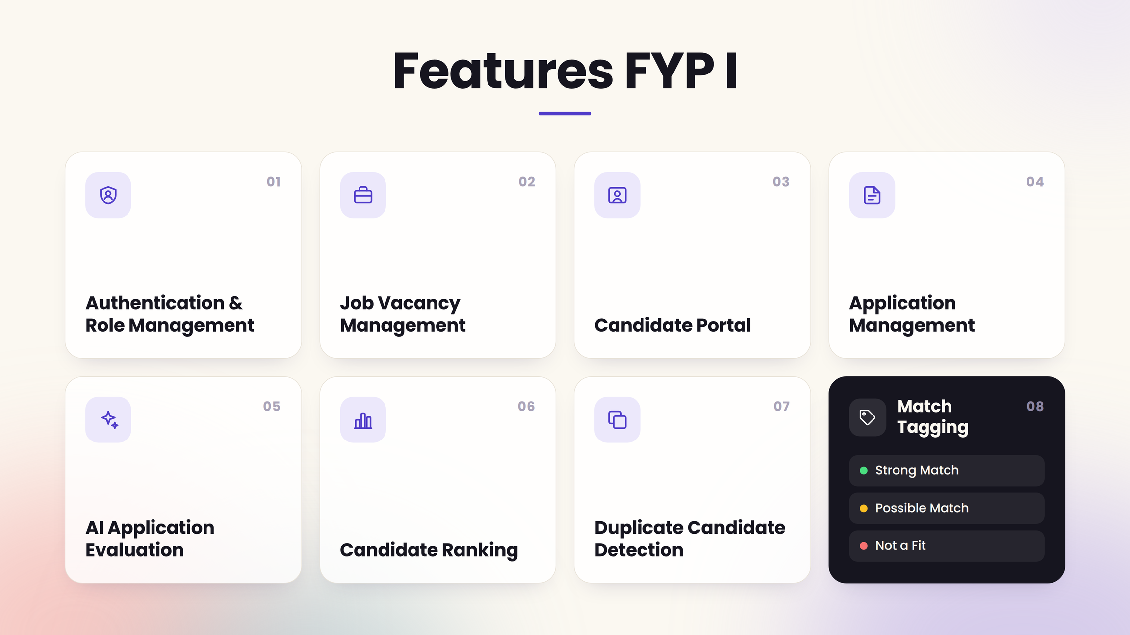

Features FYP I
6

Slide 7
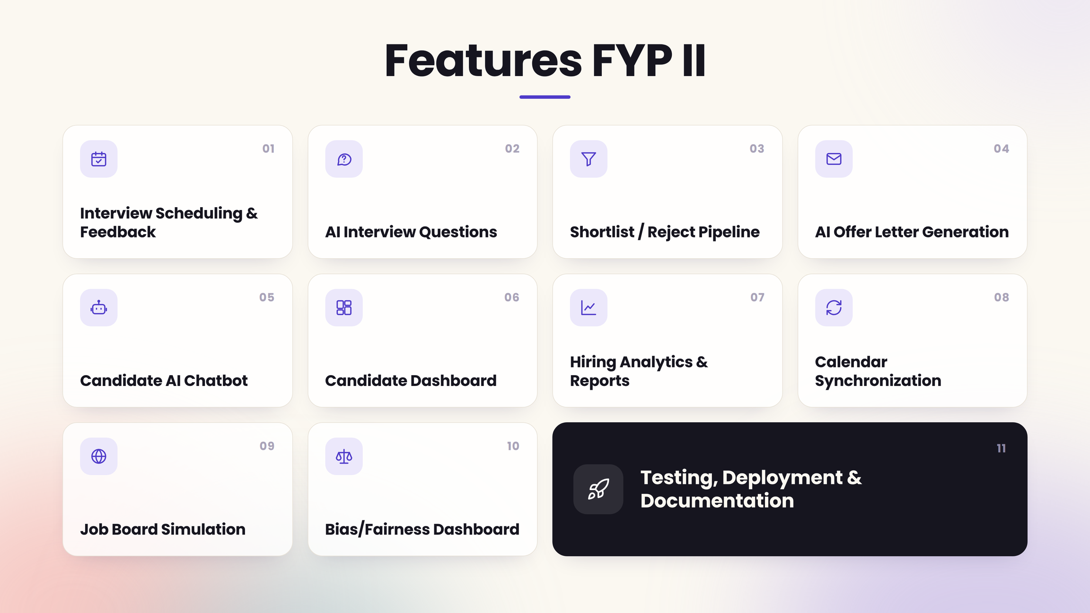
Features FYP II
  Interview Scheduling & Feedback
  AI Interview Questions
  Shortlist / Reject Pipeline
  AI Offer Letter Generation
  Candidate AI Chatbot
  Candidate Dashboard
  Hiring Analytics & Reports
  Calendar Synchronization
  Job Board Simulation
  Bias/Fairness Dashboard
  Testing, Deployment & Documentation
7

Slide 8
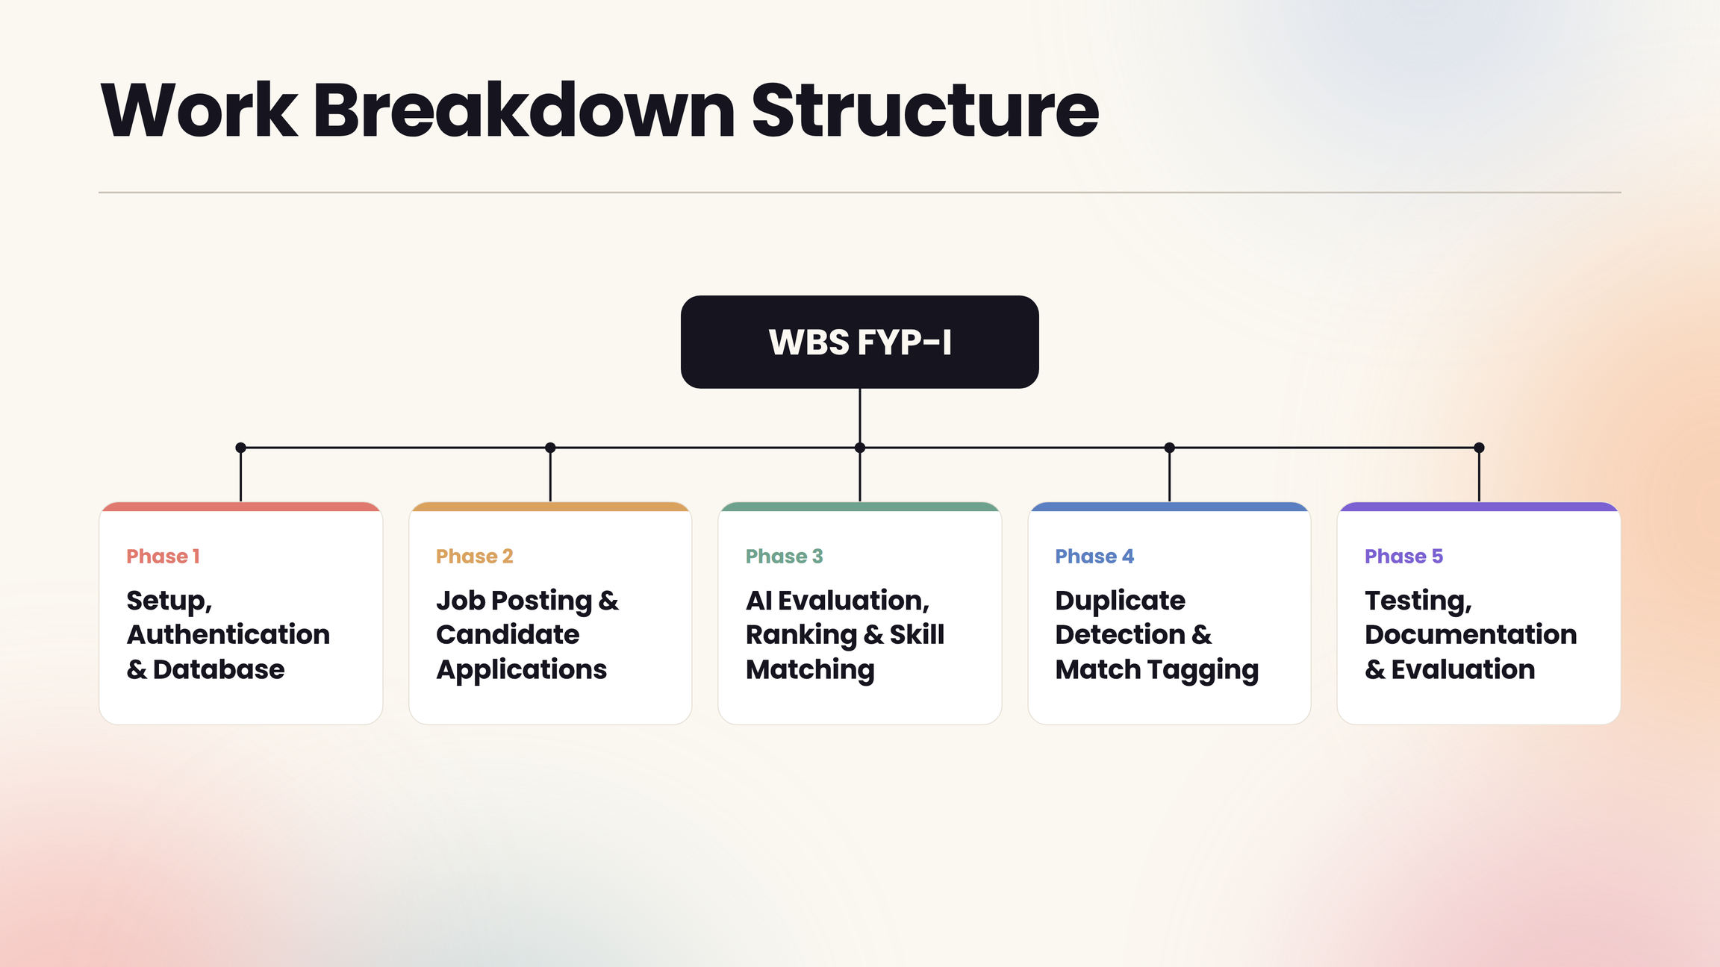
Phase 1: Setup, Authentication & Database
↓
Phase 2: Job Posting & Candidate Applications
↓
Phase 3: AI Evaluation, Ranking & Skill Matching
↓
Phase 4: Duplicate Detection & Match Tagging
↓
Phase 5: Testing, Documentation & Evaluation
Work Breakdown Structure
WBS FYP-I
8

Slide 9

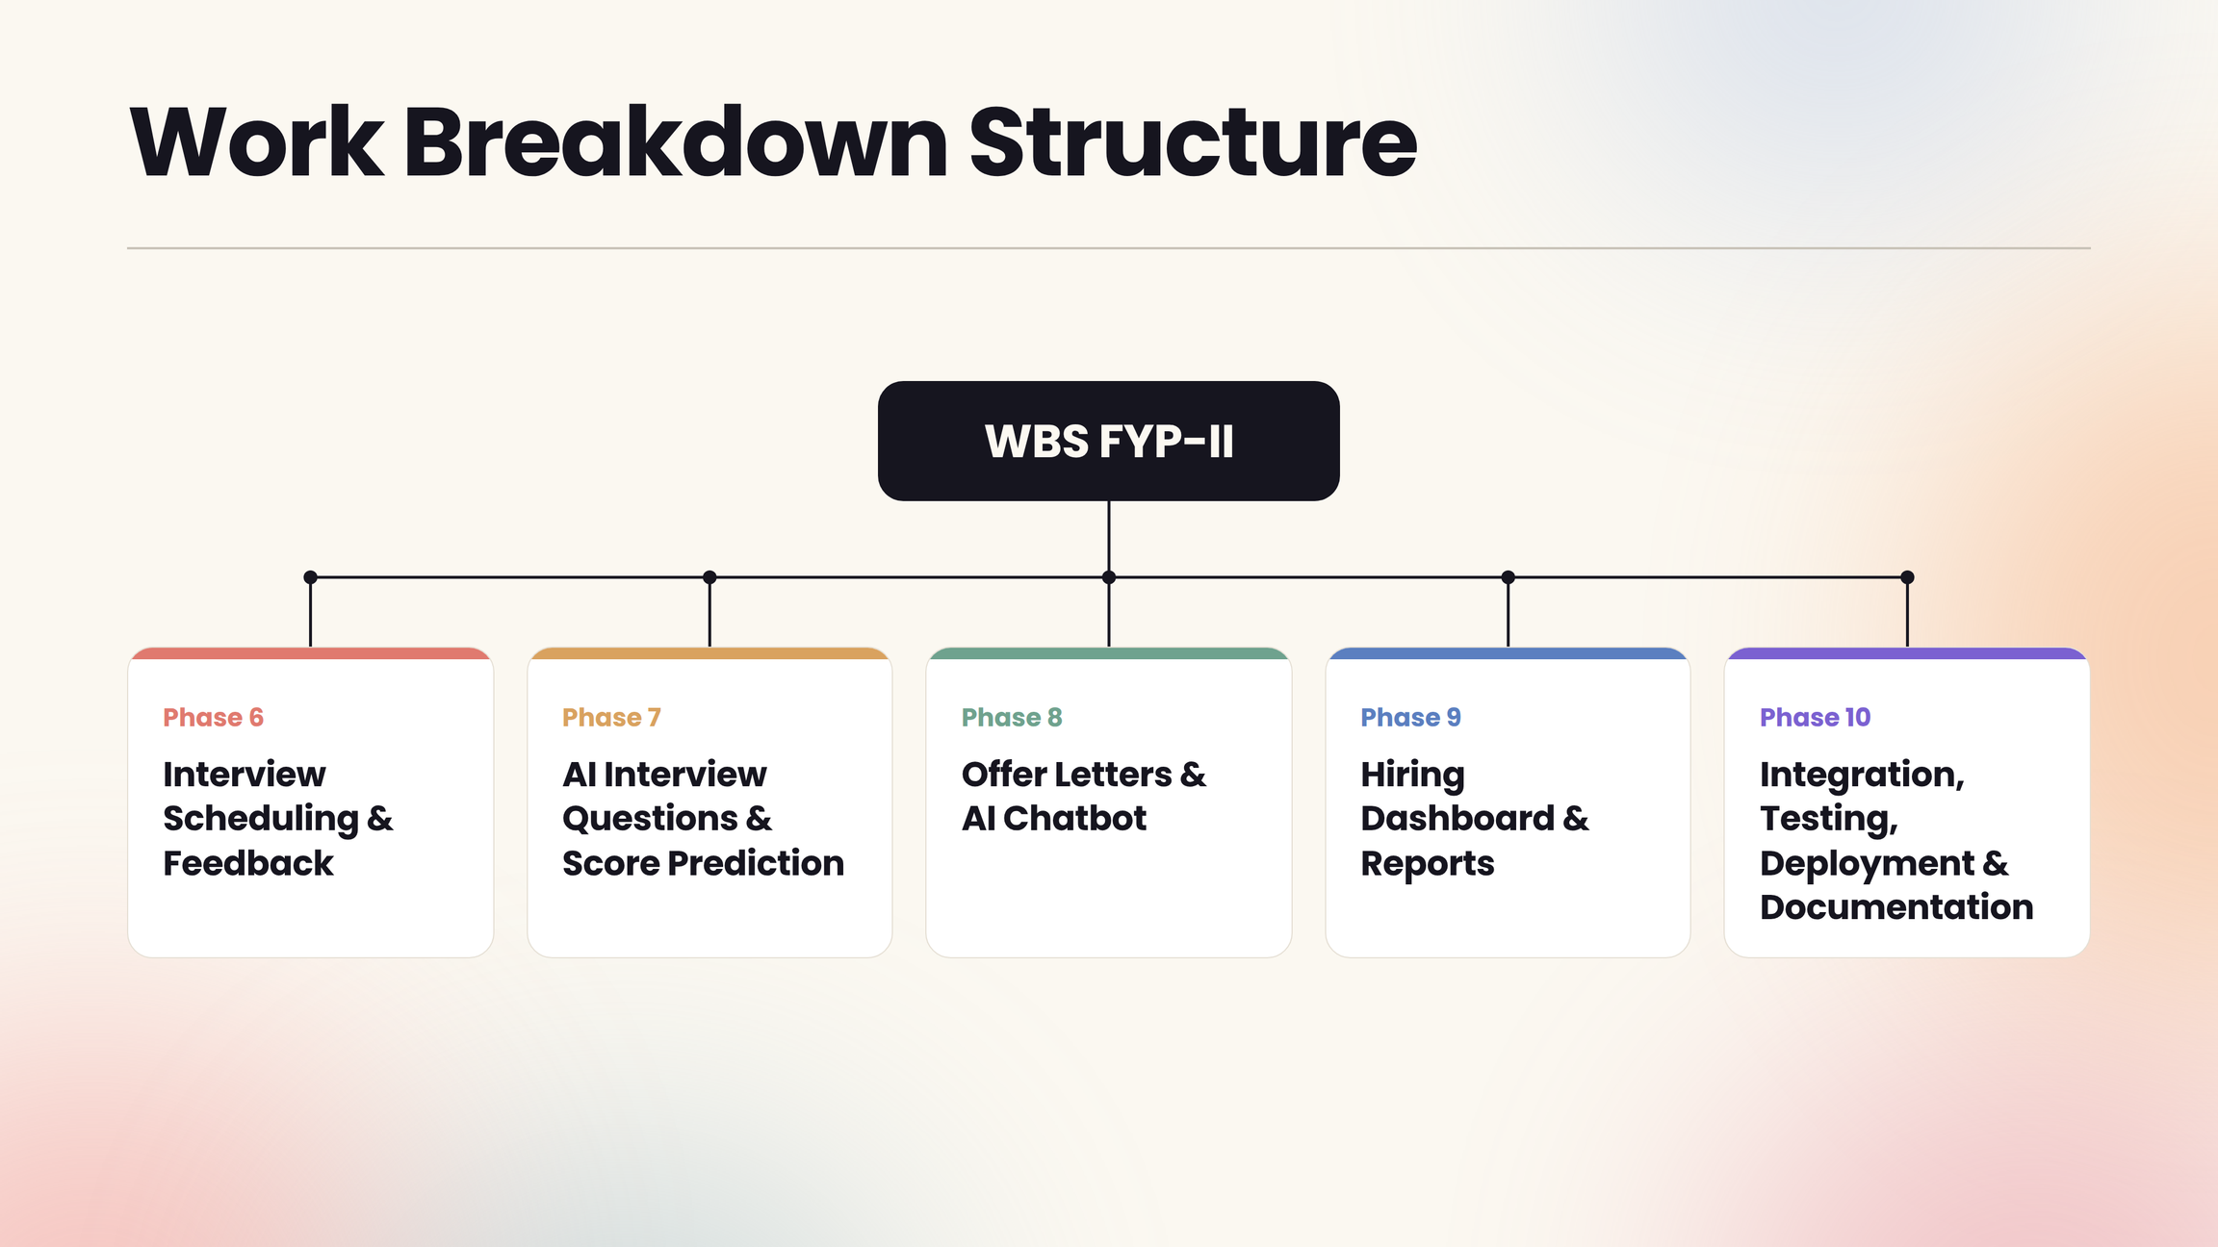
Work Breakdown Structure
9

Slide 10
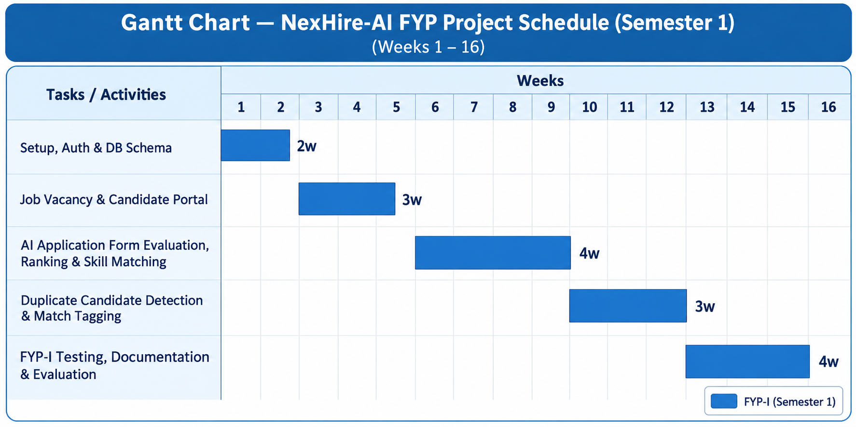
Gantt Chart FYP-I
10

Slide 11
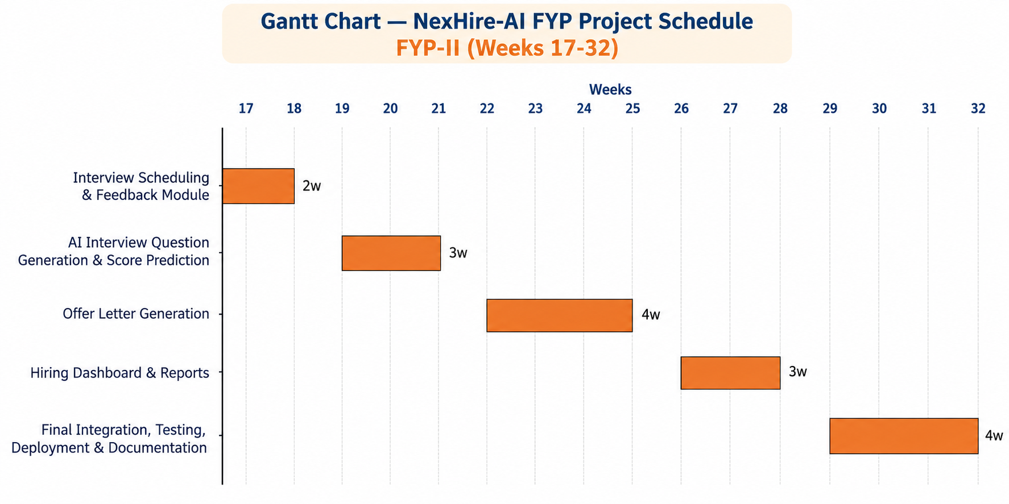
Gantt Chart: FYP-II
11

Slide 12

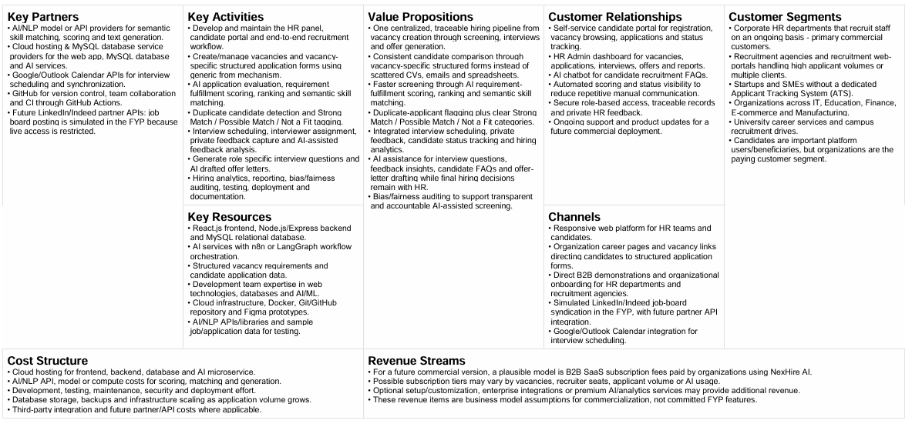
Business Model Canvas
12

